Slide 1


SMART KITCHEN SAFETY & MONITORING SYSTEM
Enhanced Safety Through Technology
Summer 2025 IoT Project
Presented by:
August 30, 2025
10:00 A.m.
Team 10

Slide 2
INTRODUCTION
"Tomorrow: your reward for working safely today."
This principle highlights the importance of proactive safety measures in daily life.
Kitchen safety, in particular, is a major concern due to risks such as
gas leaks
fire hazards
overheating appliances.
Conventional systems often lack real-time monitoring and automation, which delays hazard detection and increases the likelihood of accidents.

Slide 3
SOLUTION
This project proposes a Smart Kitchen Safety and Monitoring System that integrates an ESP32 microcontroller with:
flame, gas, temperature, and humidity sensors to continuously track environmental conditions.
A servo motor automatically opens or closes the kitchen door when unsafe levels are detected, reducing exposure to hazards.
Data is transmitted in real time via the MQTT protocol to Node-RED for processing and securely stored in Supabase.
Users can monitor live readings, receive alerts, and access historical records through a Flutter mobile application, which connects to HiveMQ for real-time monitoring and to Supabase for authentication.

Slide 4
SOLUTION
By combining IoT devices, cloud services, and mobile applications,
the project ensures continuous monitoring and automated safety responses.
This approach contributes directly to the Sustainable Development Goals (SDGs)
Good Health and Well-Being.
Sustainable Cities and Communities, by promoting healthier living conditions, safer homes.
innovative smart infrastructure for sustainable communities.

Slide 5
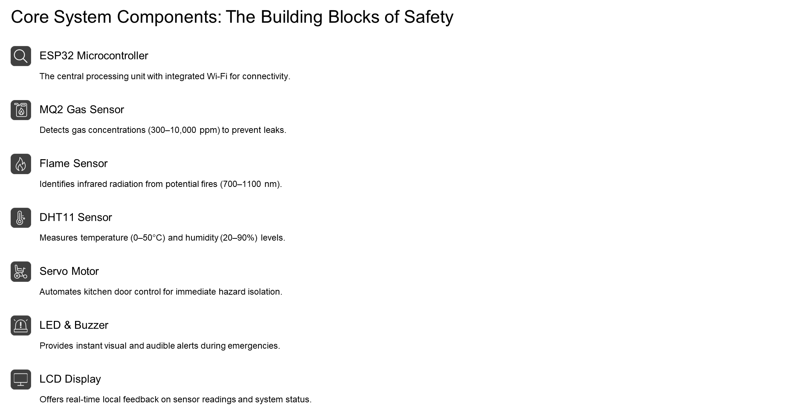

Slide 6
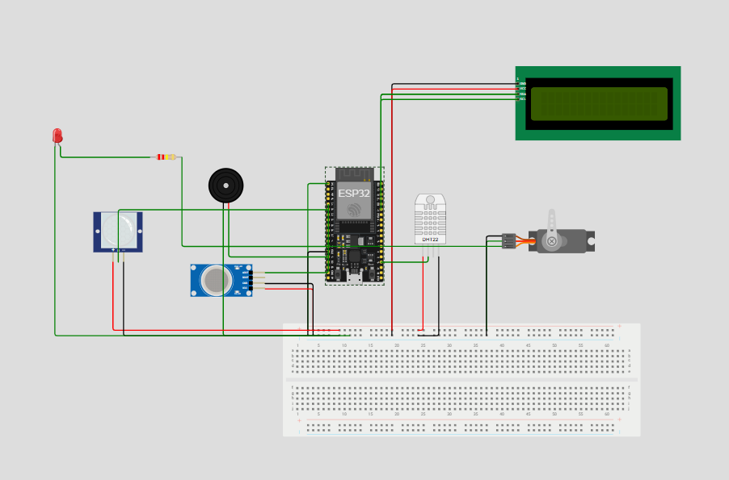
WOKWI SIMULATION

Slide 7
PROCEDURES OF THE SYSTEM:
IoT Sensors
Continuously monitor environmental parameters (gas, flame, temperature, humidity).
Send raw data to ESP32.
ESP32 Microcontroller
Receives sensor input and compares it against predefined thresholds.
If threshold exceeded → activates local alarms:
Buzzer (audible alert)
LED (visual alert)
Servo motor ( closes simulated door)

Slide 8
PROCEDURES OF THE SYSTEM:
MQTT Broker (HiveMQ)
ESP32 publishes sensor data to topics like:
kitchen/gas
kitchen/flame
kitchen/temperature
kitchen/humidity
Acts as a central communication hub.
Node-RED
Subscribes to relevant MQTT topics.
Processes data using logic flows:
Check for dangerous levels → trigger alerts
Store readings in Supabase
Send commands to actuators (e.g. close door)
Enables automation and decision-making.

Slide 9
PROCEDURES OF THE SYSTEM:
Supabase Database
Stores all historical sensor readings and event logs.
Supports real-time sync and authentication.
Used by Flutter app to fetch past incidents and user data.
Flutter Mobile App
Authenticates users via Supabase (email/password).
Connects to MQTT broker to receive live sensor updates.
Displays:
Current values (gas, flame, temp, humidity)
Device states (door open/close)
Danger/safe status:
Incident history with timestamps.
Allows users to manage sensors.

Slide 10
PROCEDURES OF THE SYSTEM:
Actuator Controls
Triggered by Node-RED when danger is detected.
Examples:
Servo to close kitchen door (in maquette)
Kitchen Maquette
A physical model made of cork and cardboard.
Simulates a real kitchen environment.
Shows visual feedback (e.g., door closing) when a hazard is detected.

Slide 11
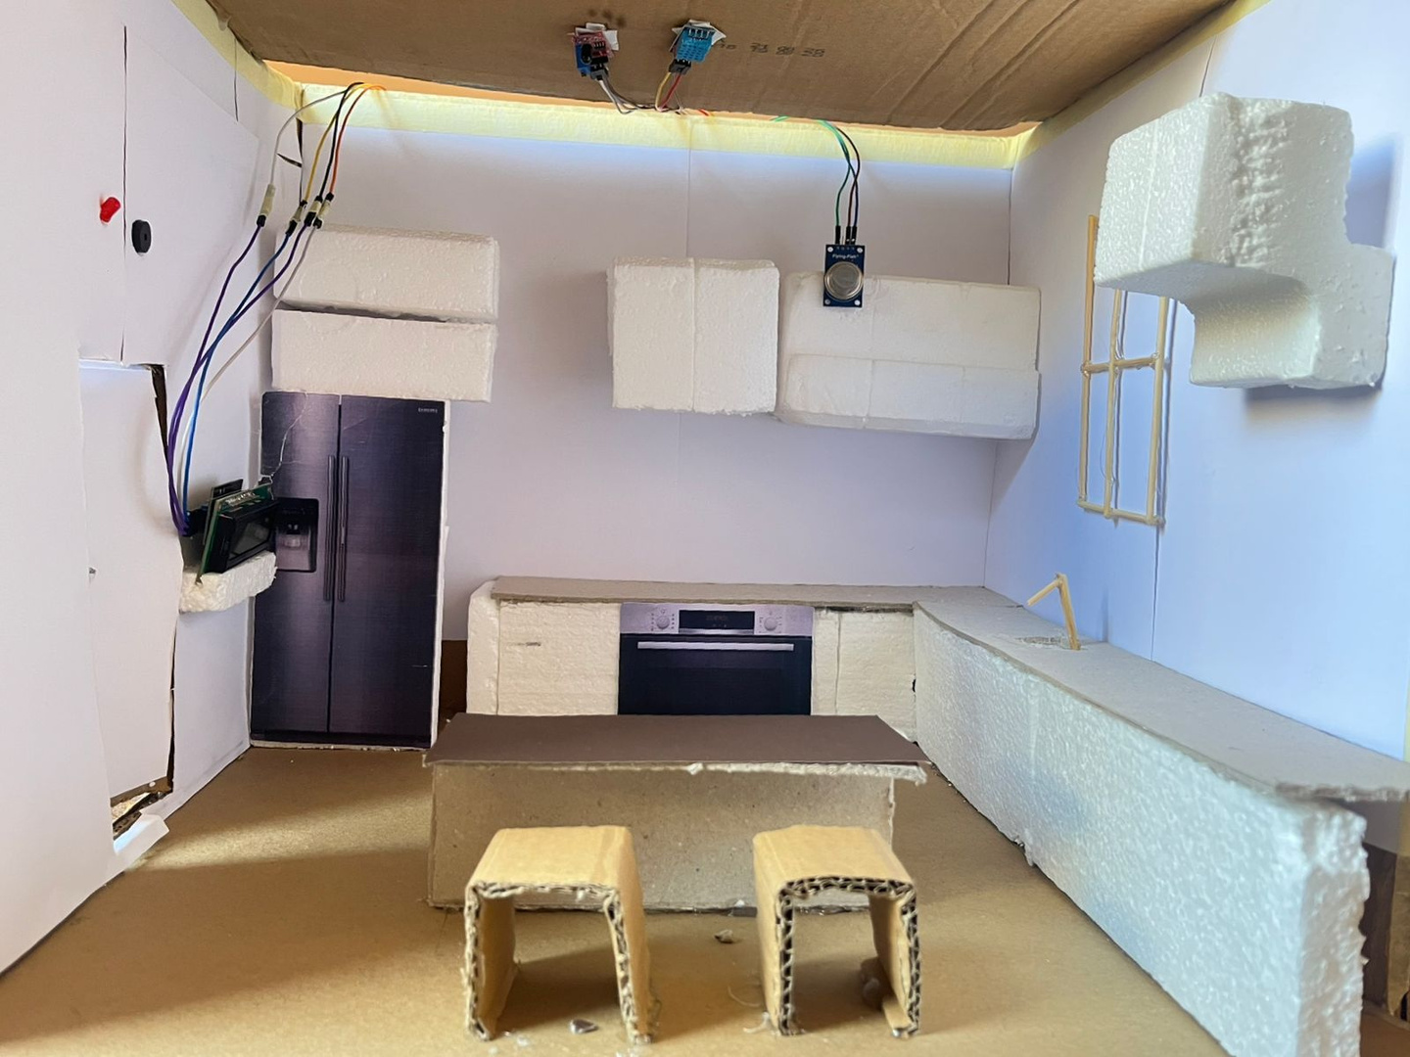
MAQUETTE

Slide 12
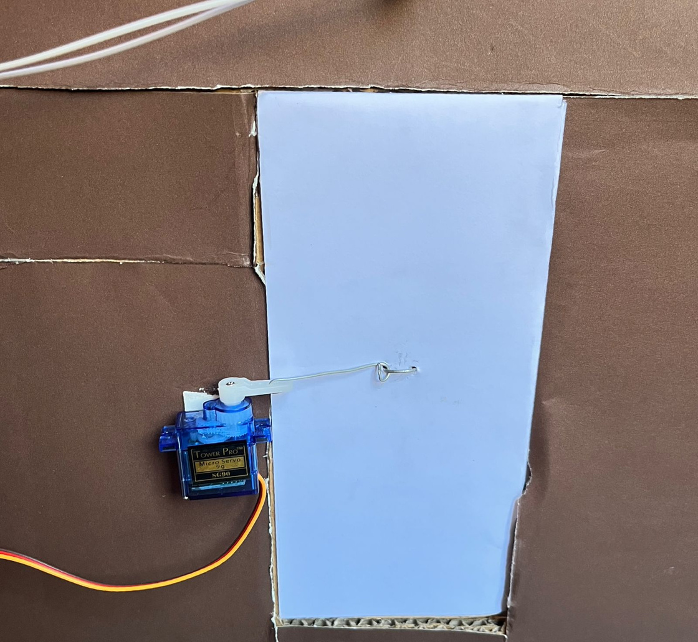
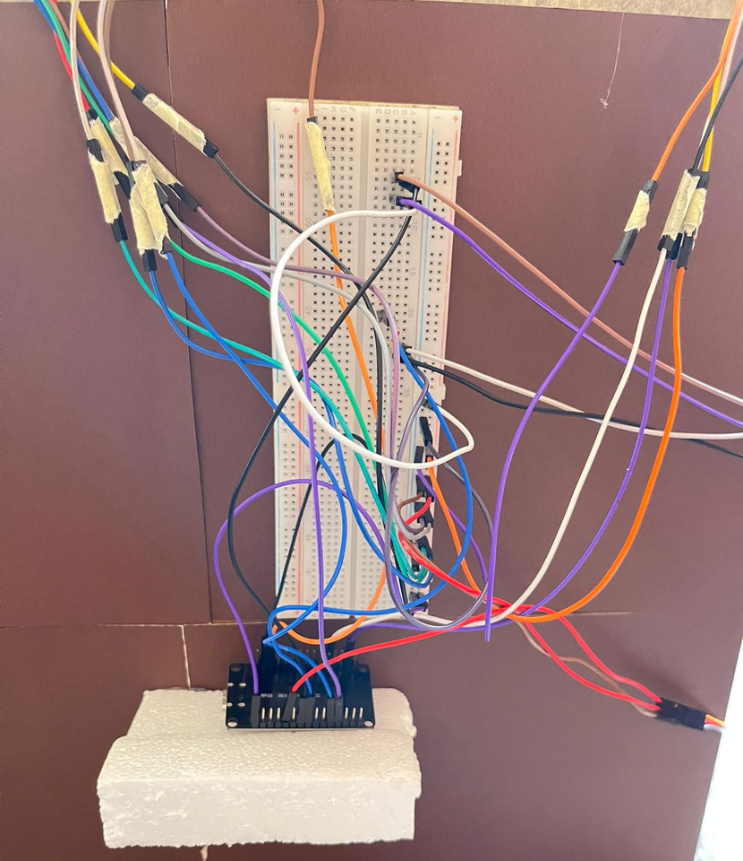
MAQUETTE

Slide 13
PROBLEMS FACED
Sensor Calibration – MQ2 and Flame sensors require proper calibration for accuracy.
test sensors - to know the perfect thresholds.
False Alarms – Steam, humidity, and smoke from cooking may trigger false alerts.
Connectivity – Wi-Fi instability can delay cloud updates.
Integration – Synchronizing ESP32 → MQTT → Node-RED → Supabase →Flutter smoothly.
Power Stability – Ensuring ESP32 and sensors remain stable under load.

Slide 14
FUTURE WORK:
Incorporate an automated shutoff valve for the gas supply that is triggered by multiple hazard conditions, such as gas leakage, flame detection, or abnormal temperature levels. This feature would not only prevent gas-related accidents but also act as a proactive safety measure in fire scenarios, ensuring faster containment and minimizing potential damage.
Introduce a presence-detection feature, like using PIR motion sensors, to ensure the door does not close immediately if a person is inside the kitchen. Instead, the system can apply a delay, for example, 10 seconds before automatic closure, giving enough time for occupants, especially children, to exit safely.

Slide 15
FUTURE WORK:
Incorporate a battery backup system to ensure continuous operation during power outages. This would keep the sensors, ESP32, and communication modules active even when electricity is cut off, guaranteeing uninterrupted monitoring and safety alerts in critical situations.

Slide 16
USE CASE EXAMPLE
GAS LEAK DETECTED
Gas sensor detects high concentration → sends signal to ESP32.
ESP32 triggers buzzer and LED locally.
ESP32 publishes "gas=reading" to MQTT topic.
Node-RED receives message → checks threshold → stores in Supabase.
Node-RED sends command to relay to make the servo rotate.
Flutter app receives notification: “ Danger!”
User sees incident in app with timestamp and value.
In maquette: servo closes door automatically.

Slide 17
CONCLUSION
In conclusion, our project achieves:
Real-time monitoring and alerts for hazardous events.
Automatic preventive actions (closing gas valve via servo, alarms).
Cloud-based storage and analysis for long-term insights.
User-friendly mobile application for control and awareness.
A scalable and future-proof design that can evolve into a full smart-home solution.
This work demonstrates the potential of IoT in saving lives, reducing risks, and building smarter, safer environments.

Slide 18
Thank You
For your attention

